Slide 1
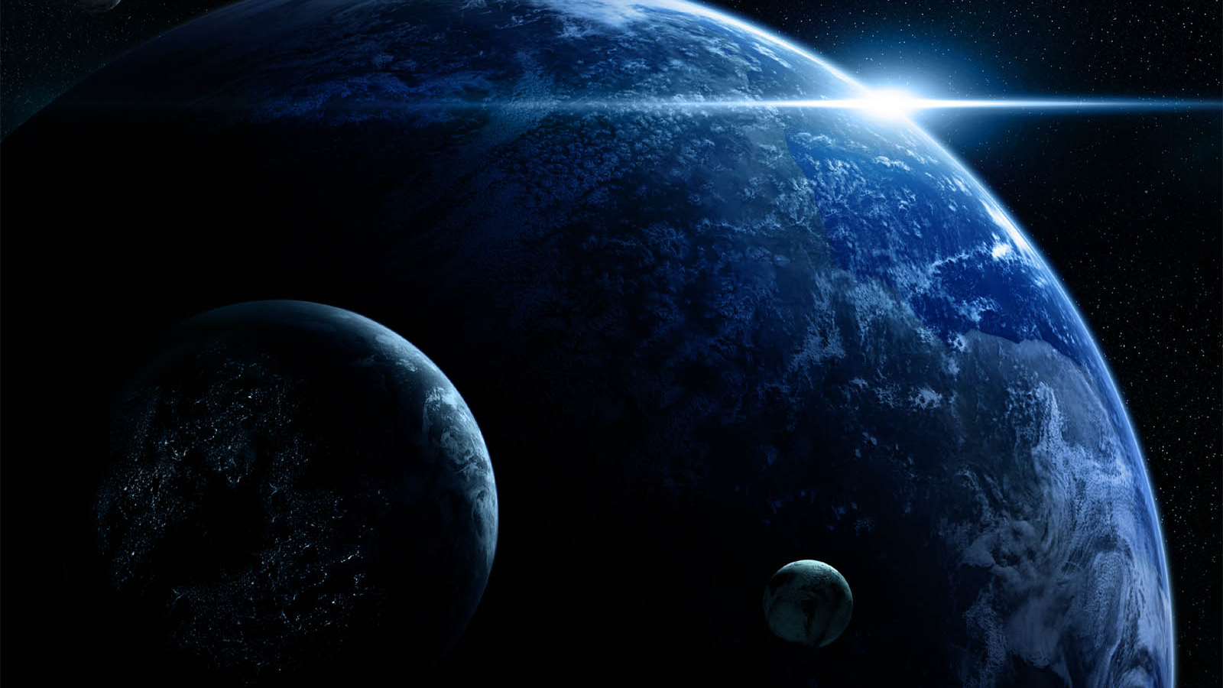

National Aeronautics and
Space Administration
Modeling Solar System Objects driven by Comparative Planetology and Exoplanetary Observations
Allison Payne, Gerónimo Villanueva, Vincent Kofman, Thomas Fauchez
NASA Goddard Space Flight Center
CRESST/University of Maryland
Greenbelt, MD, USA

Slide 2
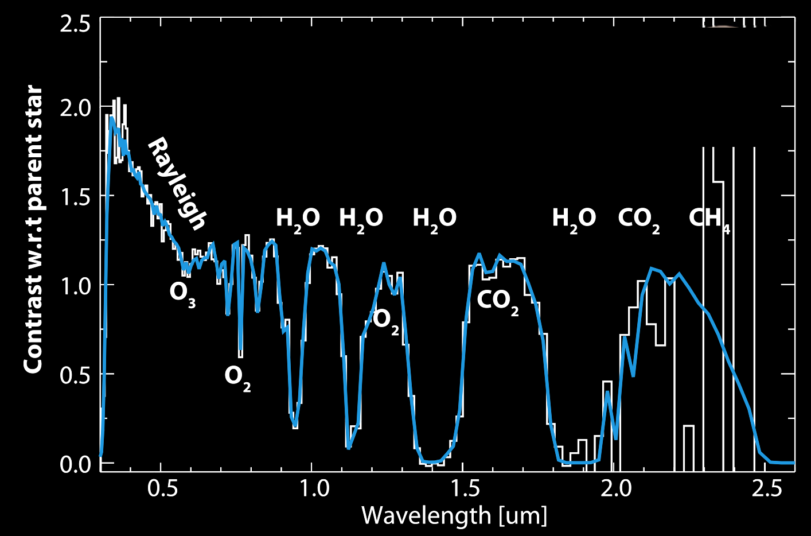
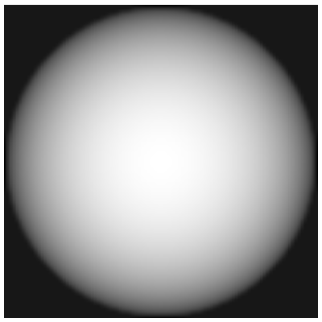
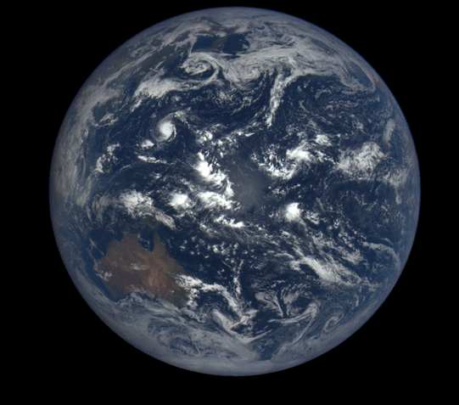
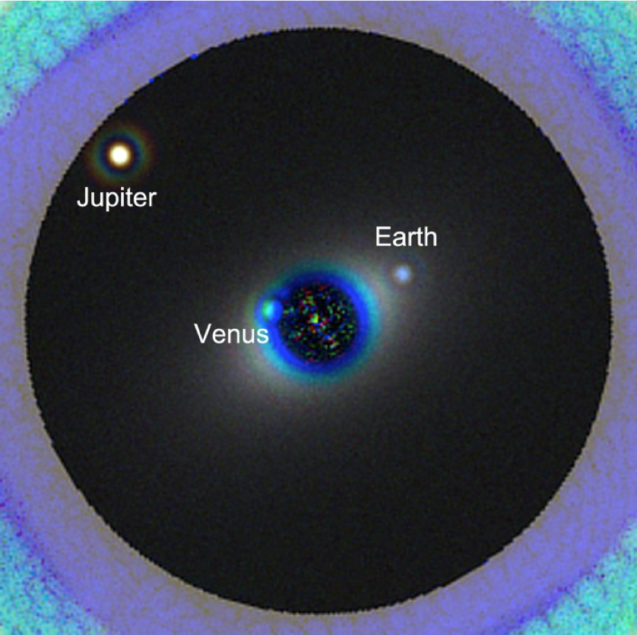
Lambert sphere
Homogenous composition (1D)
Simplified illumination and scattering
No temporal/seasonal variability
No active sources/sinks of gases
No realistic climate and geometry
Highly heterogenous surface and atmosphere in 3D
Complex aerosols, glint and molecular multiple scattering radiation
Strong diurnal and seasonal cycles
Dynamic sources and sinks of gases
Coronagraph view, Pueyo, Roberge et al.
Notes:
Link to google doc notes for this slide: https://docs.google.com/document/d/1-AytKQWWtdxtmunhYLt3dXIW1EaZY46CszJtos_1k2I/edit?usp=sharing

Slide 3
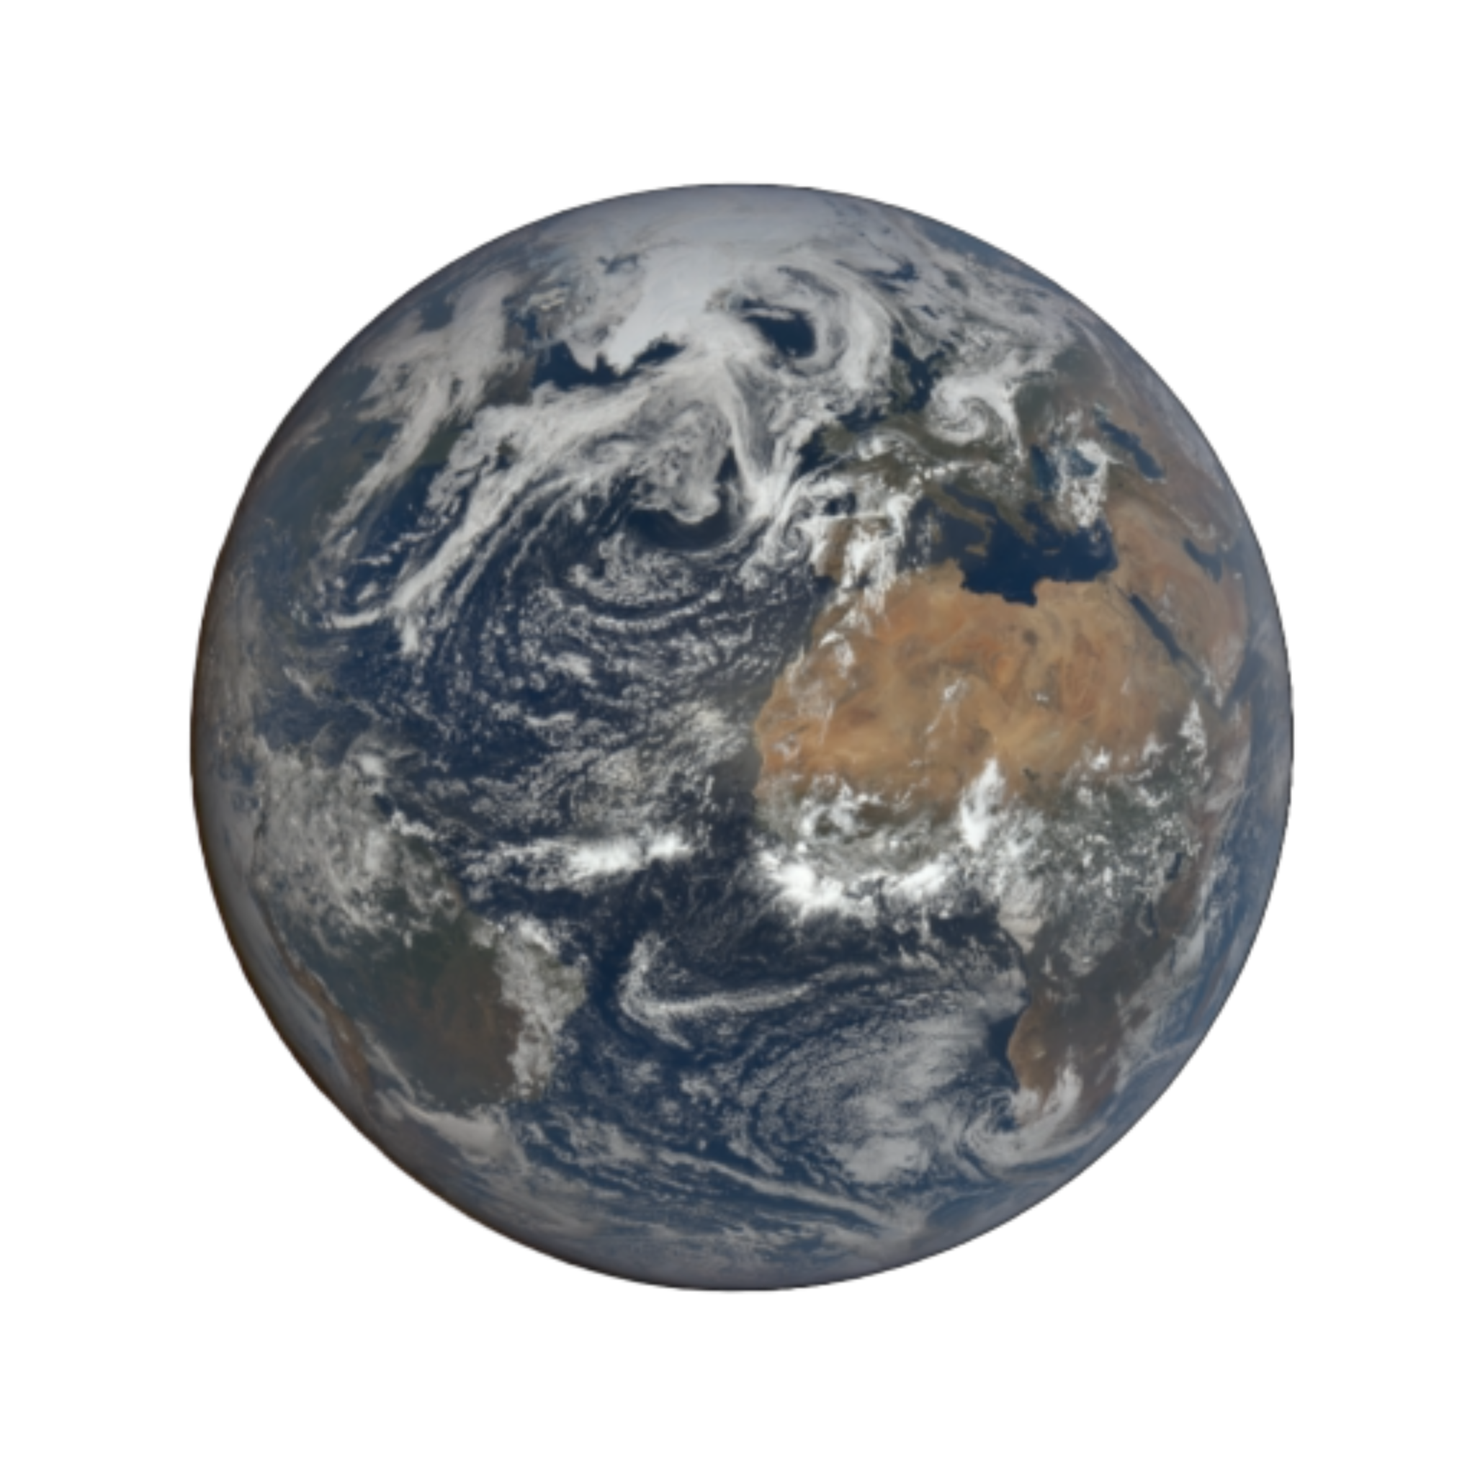
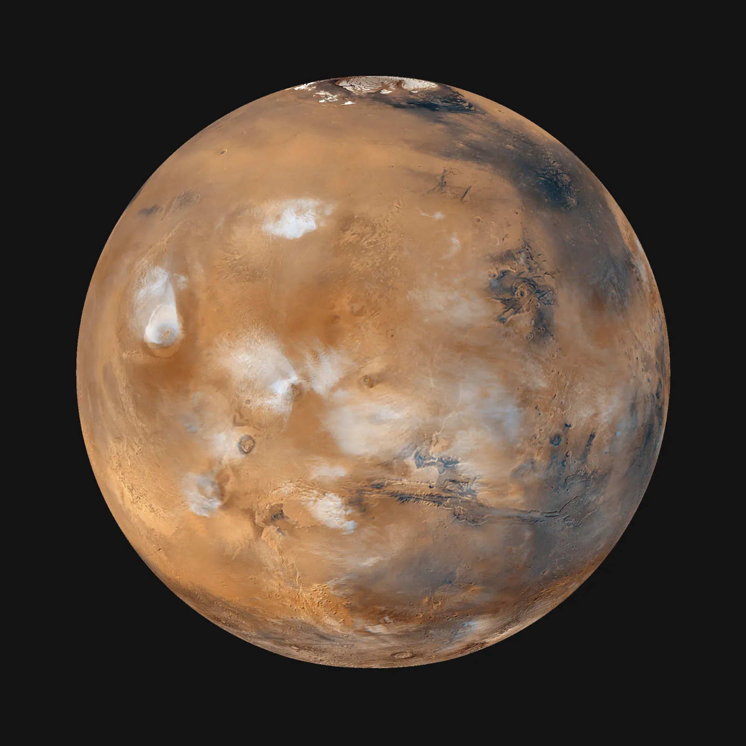
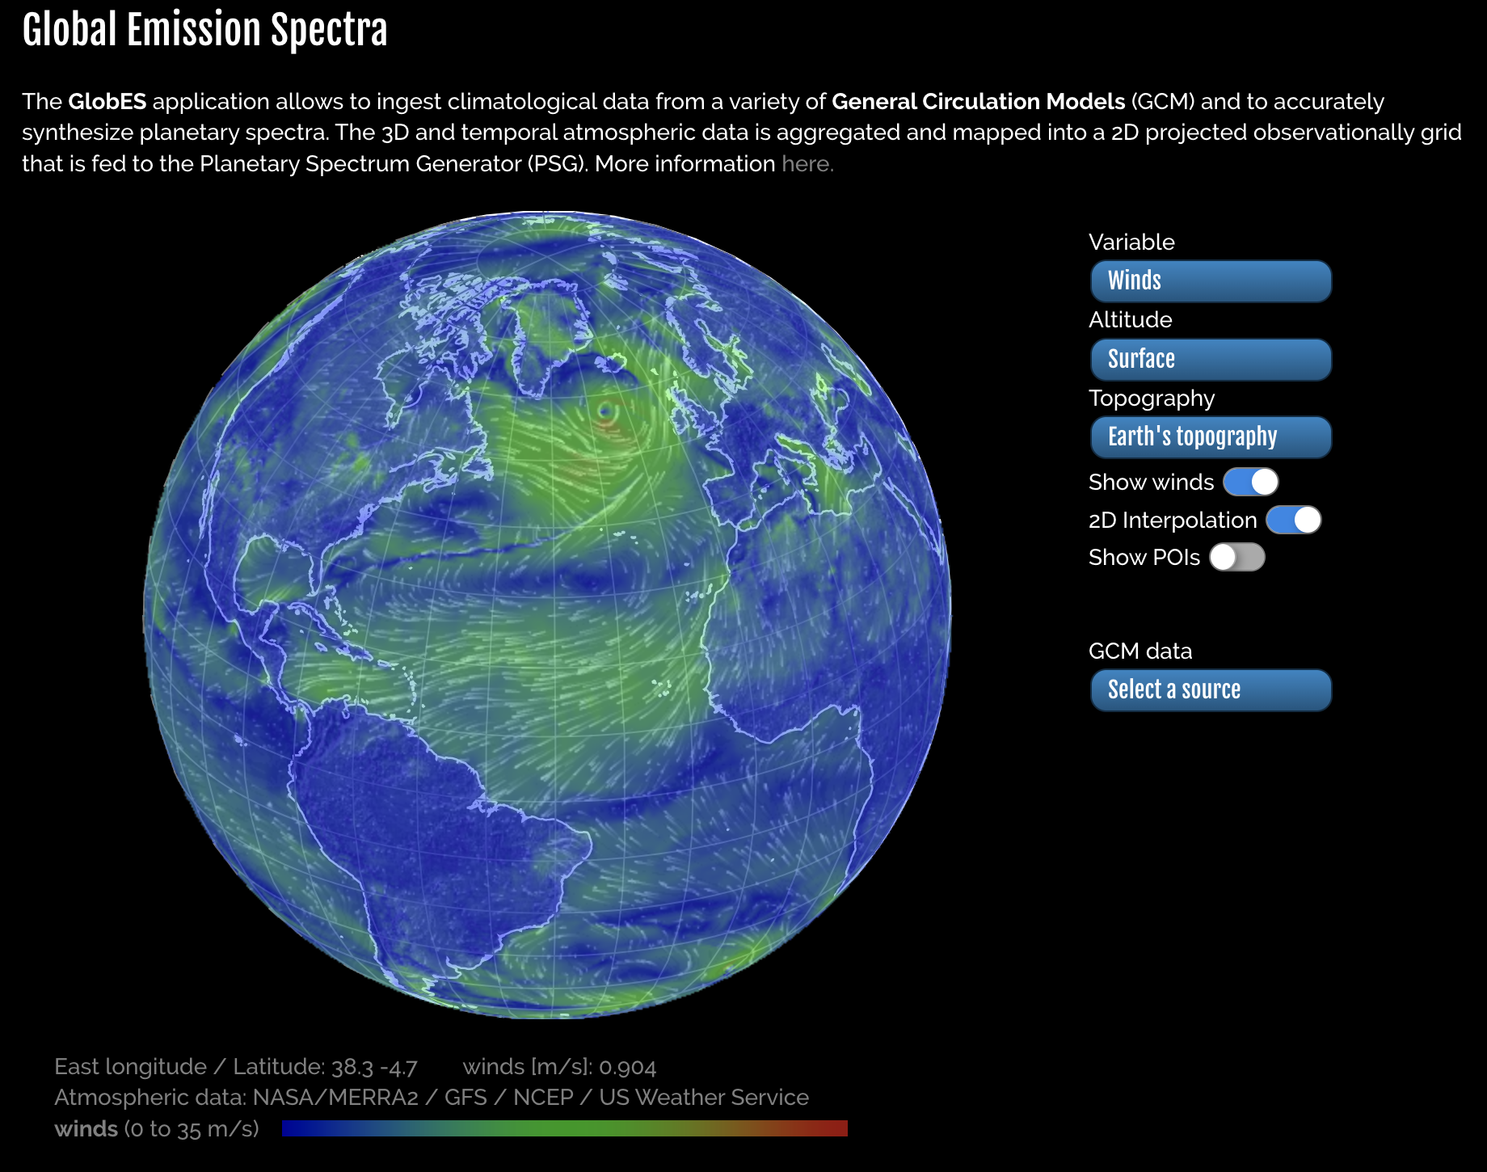

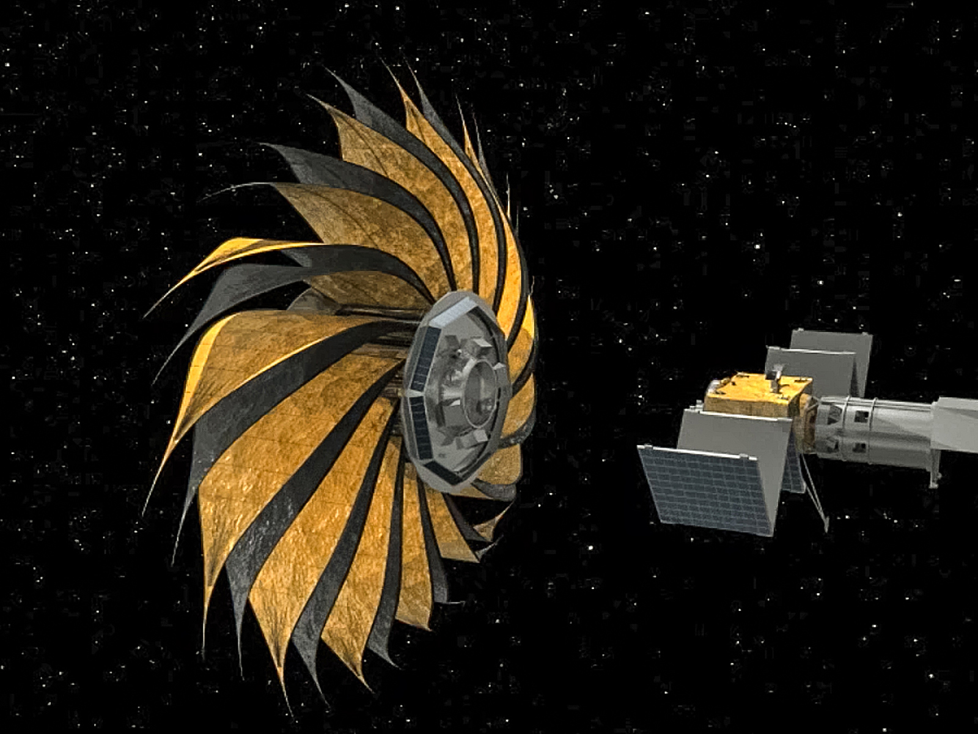
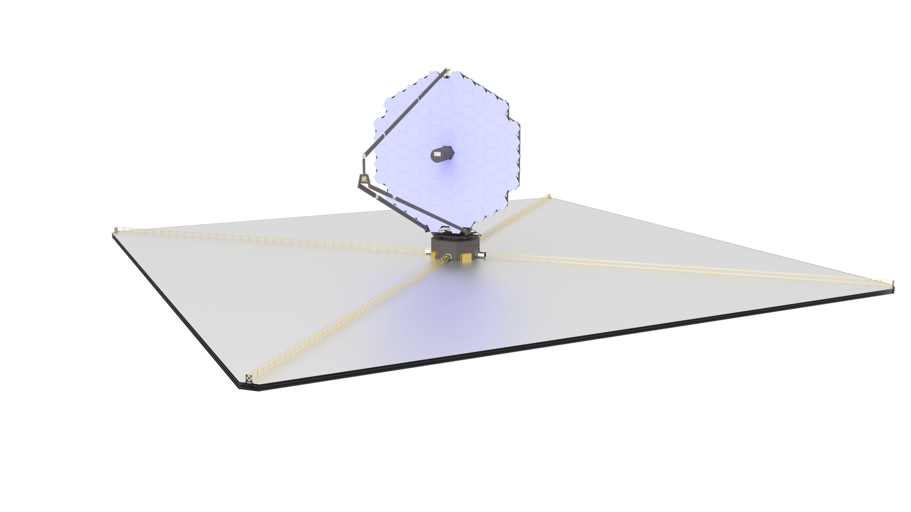
Earth: Realistic climatology from MERRA: Earth Data from MERRA-2: H₂O, CO₂, O₃, N₂O, CO, CH₄, O₂, N₂ and MODIS surface composition
Mars: Realistic climatology using LMD/MCD including dust storms and surface composition
Full 3D emission modeling with GlobES/PSG, employing a multi-scattering radiative transfer solver and advanced spectroscopy.
Realistic surface scattering modeling with compositional modeling, ocean glint and capturing seasonal evolution (e.g., ice coverage)
Realistic noise and sensitivity modeling employing coronagraph and starshade instrument models for LUVOIR, HabEx, and HWO
The noise model includes detector, optical effects and incorporate the contributions of stellar, planetary and background (e.g., exozodi, local-zodi) sources.
Notes:
Link to google doc notes for this slide: https://docs.google.com/document/d/1-AytKQWWtdxtmunhYLt3dXIW1EaZY46CszJtos_1k2I/edit?usp=sharing

Slide 4
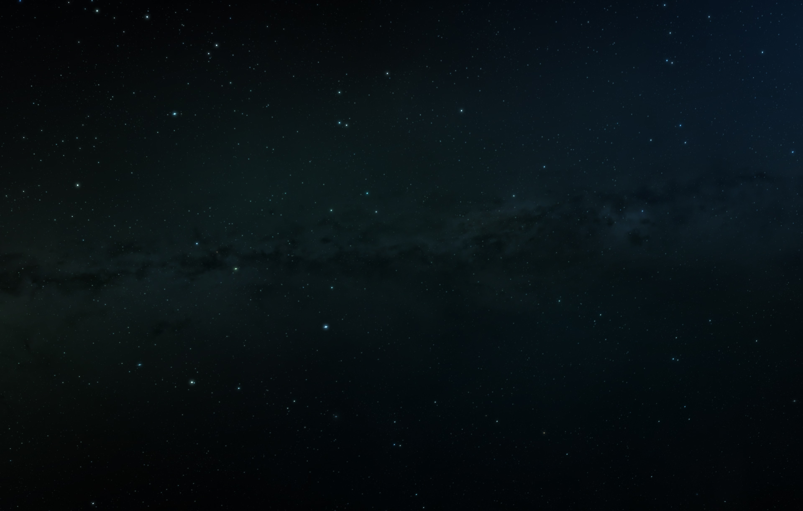
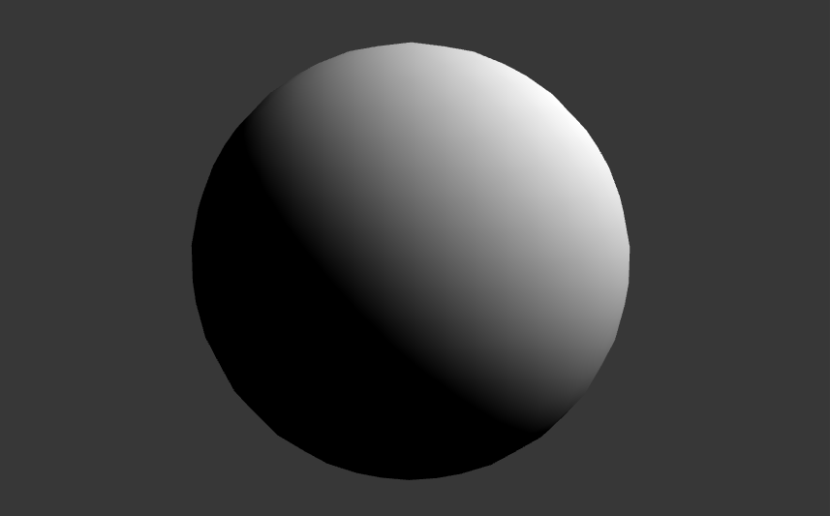
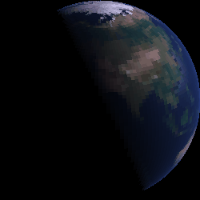
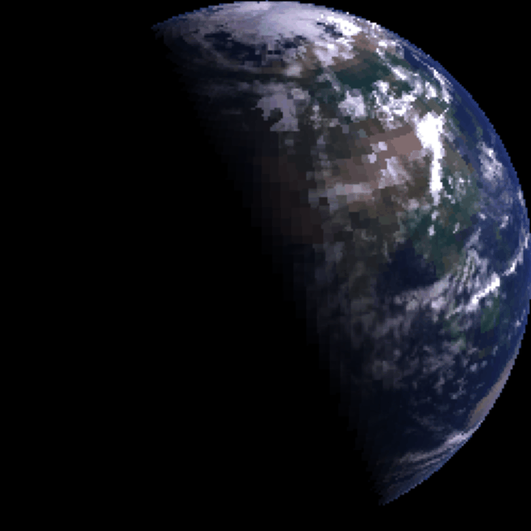
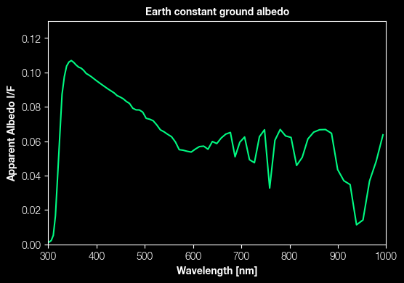
Earth Diurnal Variations
1D, NO surface, NO clouds
3D, surface, NO clouds
3D, surface, clouds
Notes:
3d modeling is the only way to comprehensively explain the variation that these plots display.

Slide 5
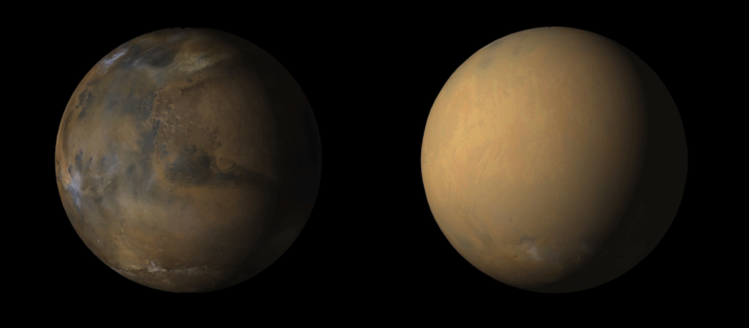
Mars
Clear Sky
Planet Sized Dust Storm
Mars Reconnaissance Orbiter (MRO)
NASA/JPL-Caltech/MSSS

Slide 6
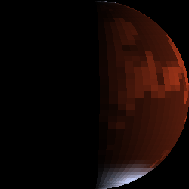
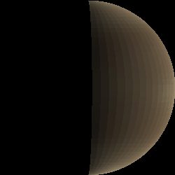
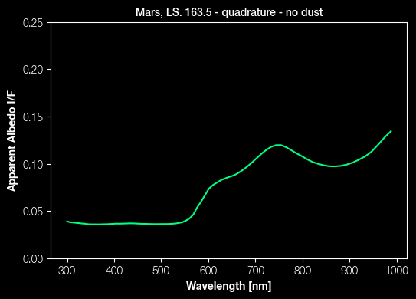
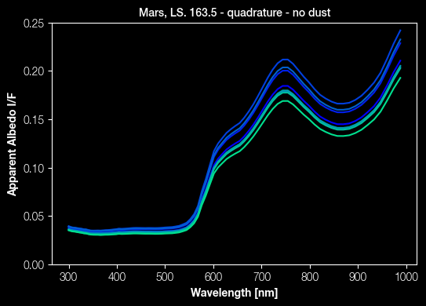
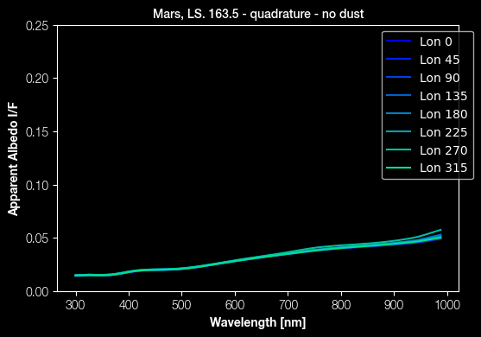
Mars Seasonal Variations
1D, NO surface, NO clouds
3D, surface, NO clouds
Work in progress:
3D simulations of dust
3D, surface, clouds
Notes:
3d modeling is the only way to comprehensively explain the variation that these plots display.

Slide 7

Diameter: 15 m
Range: 0.2 – 2 µm
IWA: 3.5 λ/D
Contrast: 1e-10
Diameter: 4 m
Range: 0.2-1.8 µm
IWA: 58 mas at 0.3–1.0 µm
Contrast: 1e-10
LUVOIR-A
HabEx (Star Shade)
HWO
Diameter: 6 m
Range: 0.2 – 2 µm
IWA: 3.5 λ/D
Contrast: 1e-10
Notes:
Link to notes on this slide: https://docs.google.com/document/d/1-KSj7uKVtddcUxaWwvHDeW39Hq2xBfKef-PphbpWH5A/edit?usp=sharing

Slide 8
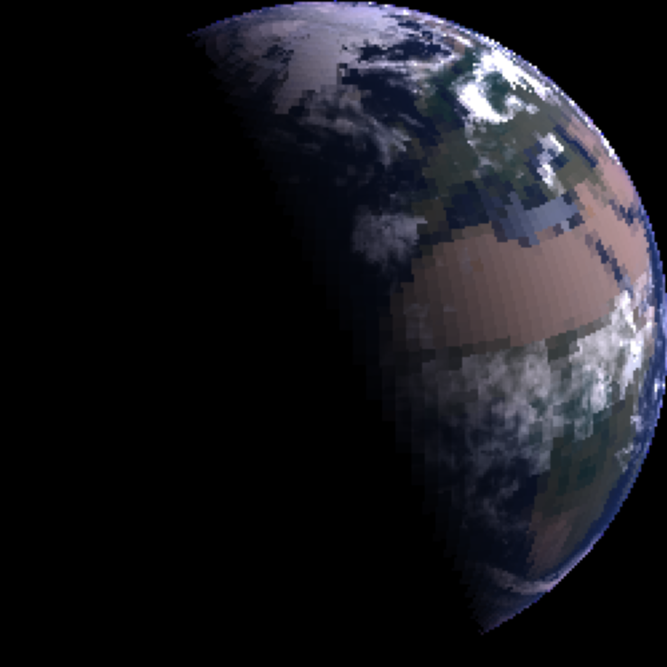
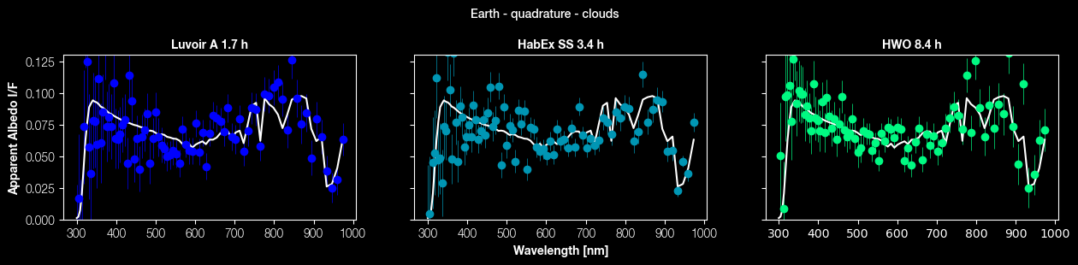
Earth observed at 10 parsec
Notes:
3d modeling is the only way to comprehensively explain the variation that these plots display.

Slide 9
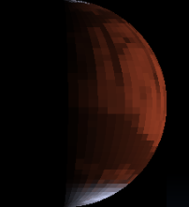
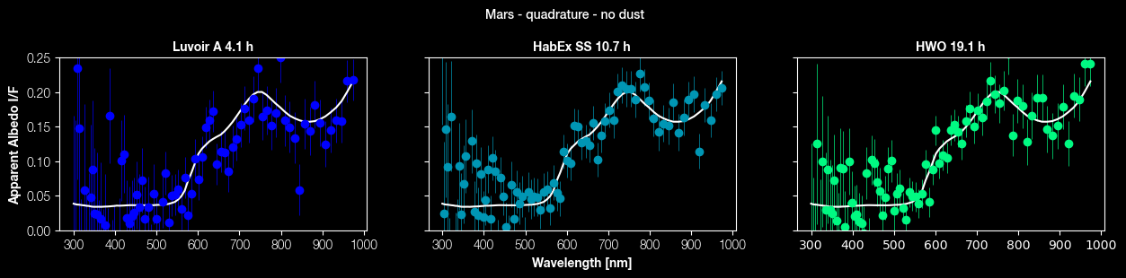
Mars observed at 10 parsec
Notes:
3d modeling is the only way to comprehensively explain the variation that these plots display.

Slide 10
Future Goals
Expand Study to include Venus & Jupiter with state-of-the-art GCMs
Enhance the SNR data by refining analysis techniques
Thank you!
Exciting new frontiers on exoplanetary research!
NASA’s PSG Tool: psg.gsfc.nasa.gov
Modeling scripts: github.com/nasapsg

Slide 11
In Conclusion
Does 3D modelling substantially impact the intensity of expected signatures?
Do short term diurnal variations & the surface composition impact the reflectance spectrum?
Why do we value 3d modeling techniques?

